Slide 1


Modeling and Estimation of Kinetic Parameters and Replicative Fitness of HIV-1
Project 2 – Milton Dario Cardenas

Slide 2
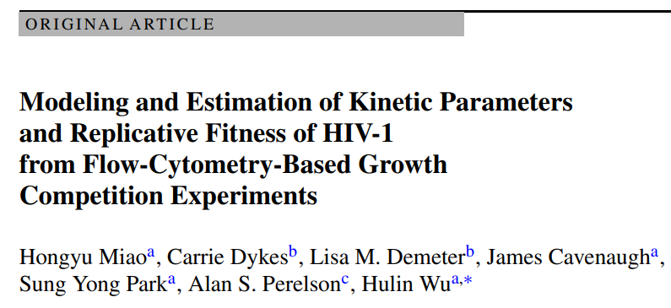

Development of three different Dynamic Models In Vitro
Estimation of kinetic parameters
Sensitivity Analysis of the model

Slide 3
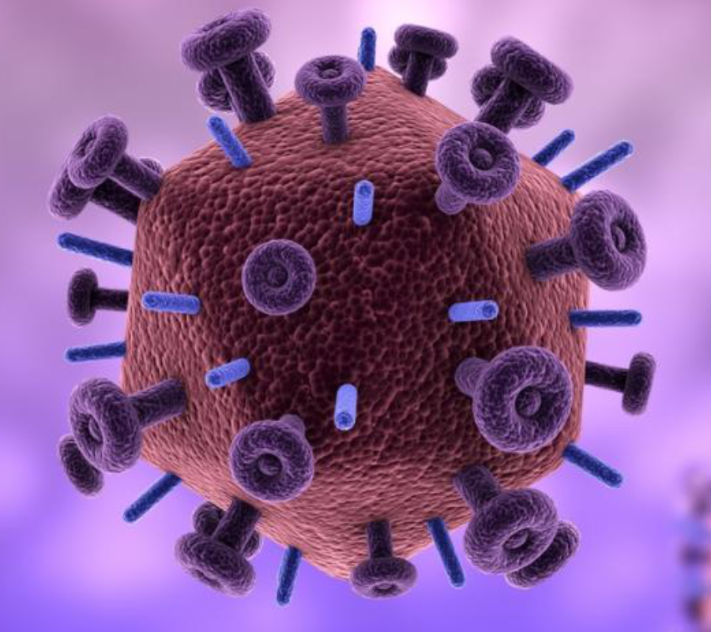
Why is it important?
- Understanding how HIV-1 replicates will:
Assist healthcare providers in deciding when to change treatments based on the progression of the infection.
Enhance our understanding of the evolution of new mutant strains of HIV-1 within patients.
Predict treatment results and the course of the disease or how it interacts with biological tissues.

Slide 4
OBJECTIVES
Estimate the necessary parameters for modeling the HIV-1 Replicative Fitness.
Do a Sensitivity analysis of the Model by modifying some key parameters.
Find the steady states of the HIV-1 replicative dynamics.

Slide 5
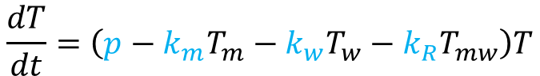
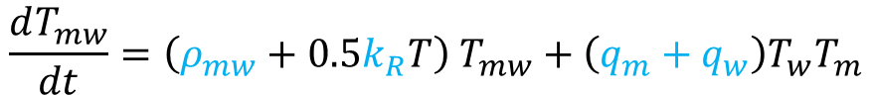
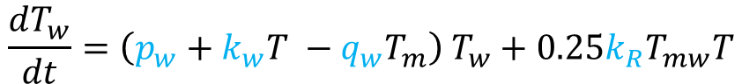

Dynamic Model For HIV-1
$$\frac{dT}{dt}=\left(p−k_{m}T_{m}−k_{w}T_{w}−k_{R}T_{mw}\right)T$$
Cells growth equation
$$\frac{dT_{m}}{dt}=\left(p_{m}+k_{m}T −q_{m}T_{w}\right) T_{m}+0.25k_{R}T_{mw}T$$
Cells infected by mutant Virus
$$\frac{dT_{w}}{dt}=\left(p_{w}+k_{w}T −q_{w}T_{m}\right) T_{w}+0.25k_{R}T_{mw}T$$
Cells infected by wild-type Virus
$$\frac{dT_{mw}}{dt}=\left(ρ_{mw}+0.5k_{R}T\right) T_{mw}+\left(q_{m}+q_{w}\right)T_{w}T_{m}$$
Cells infected by both types of virus.

Slide 6
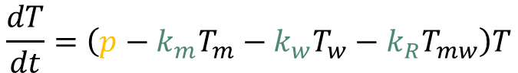
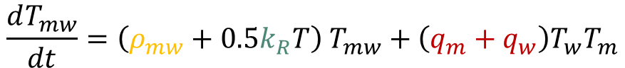
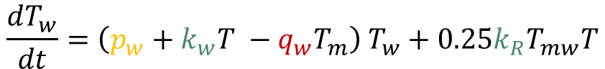
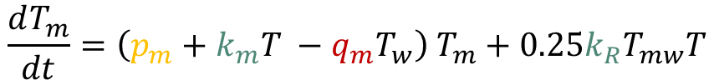
Dynamic Model For HIV-1
$$\frac{dT}{dt}=\left(p−k_{m}T_{m}−k_{w}T_{w}−k_{R}T_{mw}\right)T$$
Yellow: Growth Rates of cells
$$\frac{dT_{m}}{dt}=\left(p_{m}+k_{m}T −q_{m}T_{w}\right) T_{m}+0.25k_{R}T_{mw}T$$
Blue: Infection rate of Cells
$$\frac{dT_{w}}{dt}=\left(p_{w}+k_{w}T −q_{w}T_{m}\right) T_{w}+0.25k_{R}T_{mw}T$$
$$\frac{dT_{mw}}{dt}=\left(ρ_{mw}+0.5k_{R}T\right) T_{mw}+\left(q_{m}+q_{w}\right)T_{w}T_{m}$$
Red: Dual infection rates

Slide 7
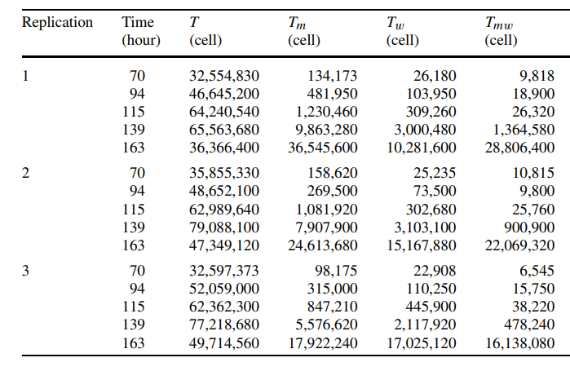
Data Available:
Magnitude difference > 10e4

Slide 8
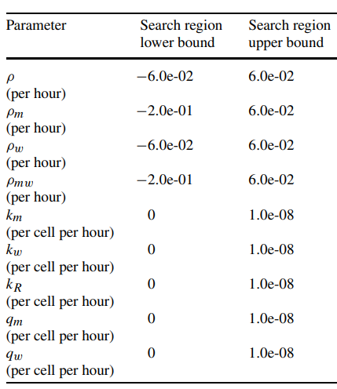
Data Fitting Process: Key Things
- Normalize the data by transforming the squared error to a logarithmic scale.
- Provide initial guesses near the values of the parameters reported in the study.
- Constrain the search algorithm to find reasonable parameters

Slide 9
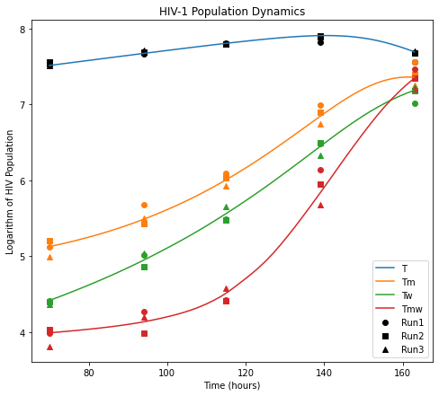
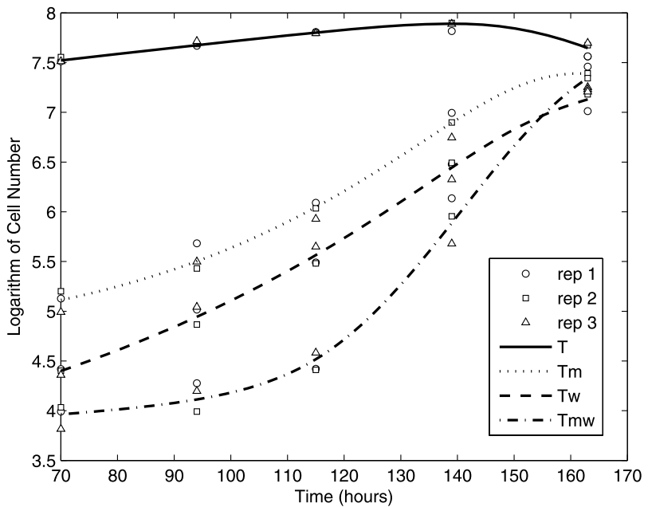
Results:

Slide 10
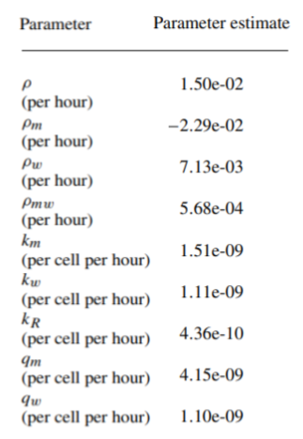
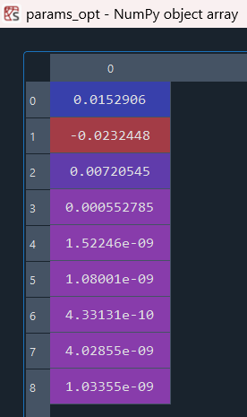
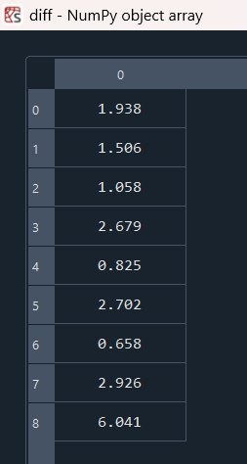
Parameters estimation:
Parameters Found
Relative Difference (%)
Parameters from the analyzed study

Slide 11
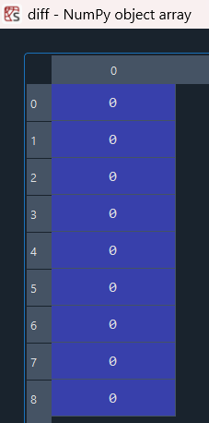
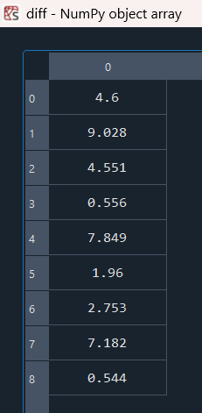
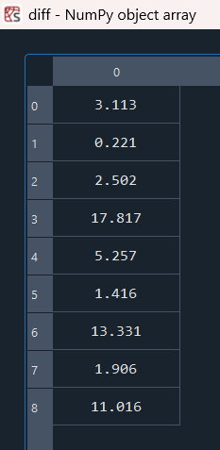
Initial guess impact on the parameters
guess = Parameters from the study
Relative Difference (%)
guess = 20 % Deviation
guess = 10 % Deviation
Relative Difference (%)

Slide 12
Takeaways Parameter Fitting:
Before using these models, it's important to carefully check the first guesses through a detailed study.
The more parameters are, the more difficult and less reliable the results become.
In scenarios where significant disparities exist among model parameters, employing techniques like data normalization or logarithmic transformation improve the model performance.

Slide 13
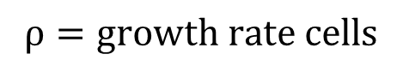
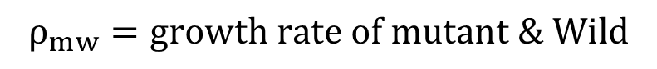
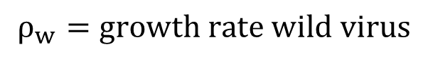
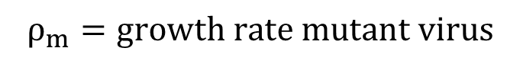
Sensitivity Analysis
$$ρ=growth rate cells$$
$$ρ_{m}=growth rate mutant virus$$
$$ρ_{w}=growth rate wild virus$$
$$ρ_{mw}=growth rate of mutant \& Wild$$
Upper level = + 10% Parameter Value
Lower level = - 10% Parameter Value
5 Different values

Slide 14
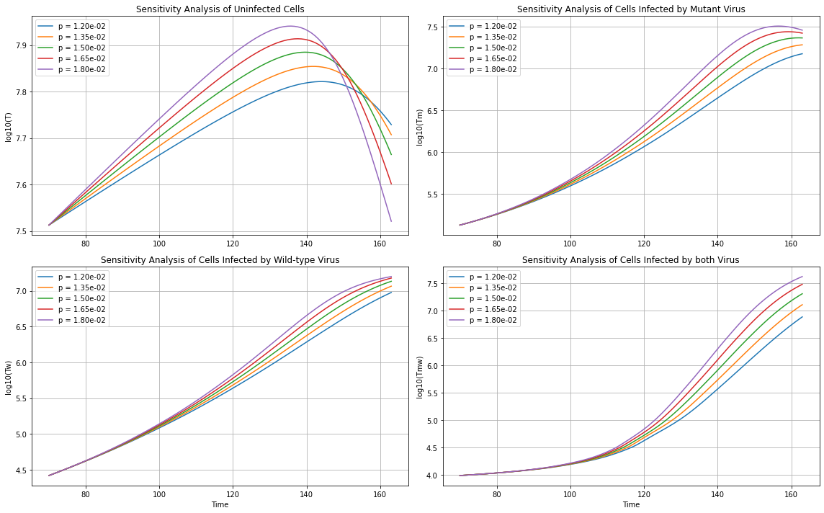
Sensitivity analysis: growth cells rate

Slide 15
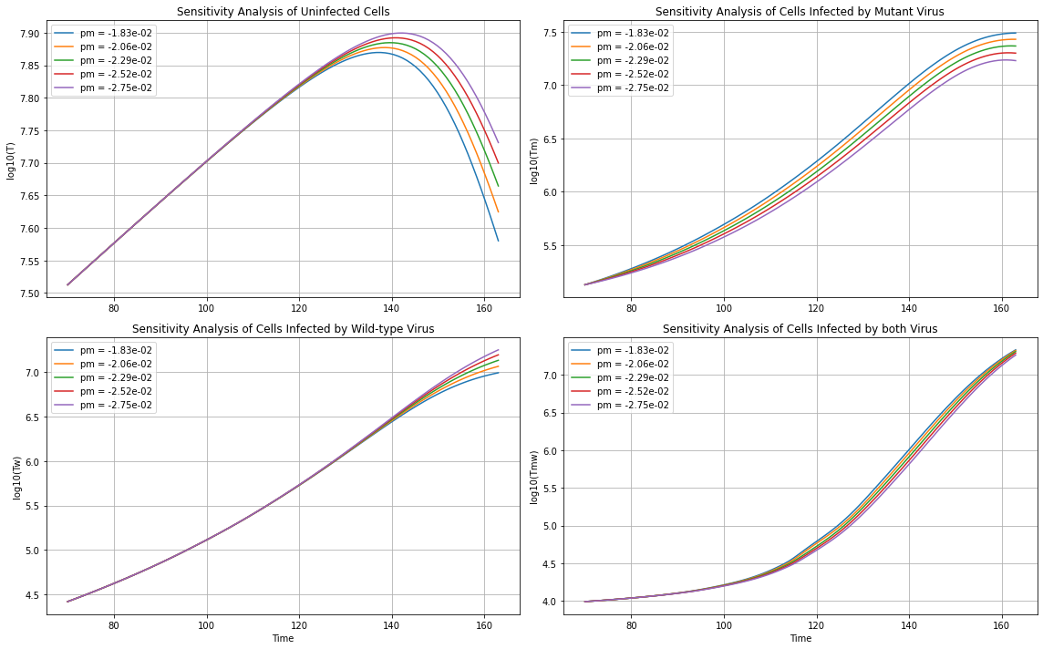
Sensitivity analysis: $growth rate mutant virus$

Slide 16
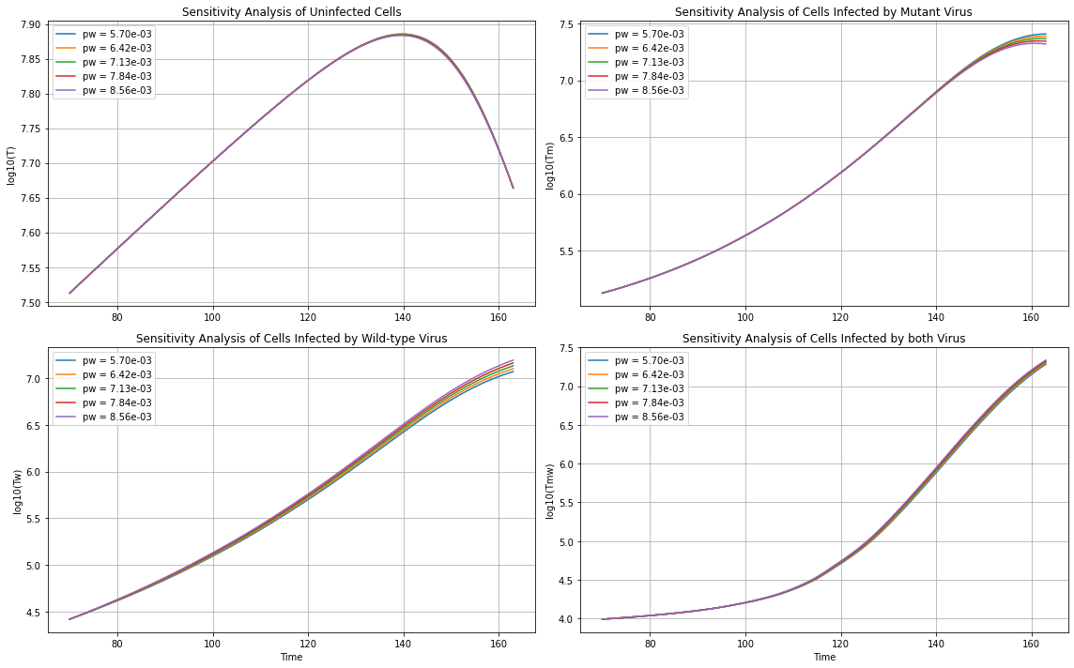
Sensitivity analysis: $growth rate wild virus$

Slide 17
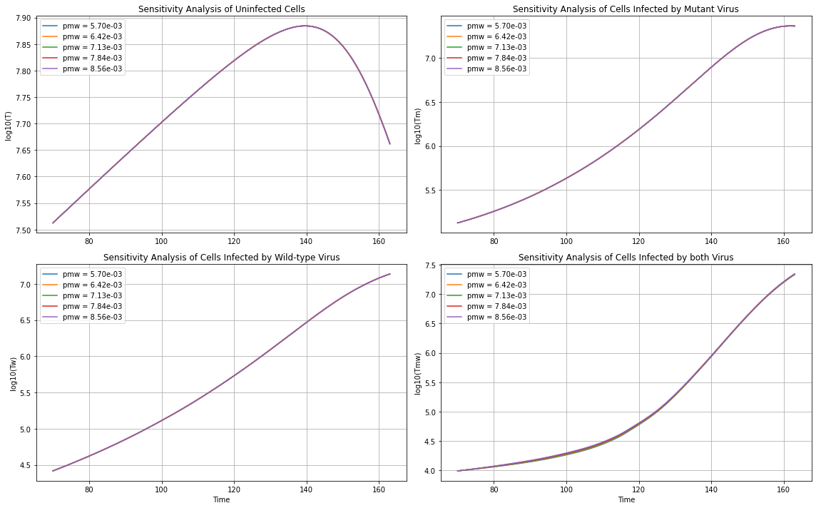
Sensitivity analysis: $growth rate mutant \& wild virus$

Slide 18
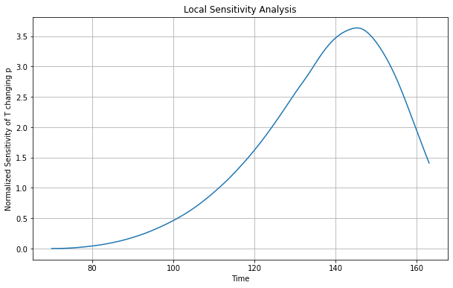
Sensitivity Analysis of growth cells rate

Slide 19
Takeaways (Sensitivity Analysis):
Sensitivity analysis reveals how changes in parameters influence model outcomes, highlighting which factors are most critical for the system's behavior.
It identifies key parameters for focused data collection

Slide 20
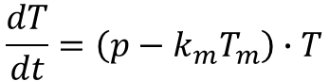
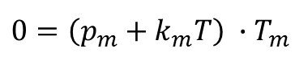
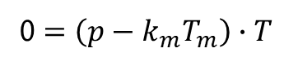
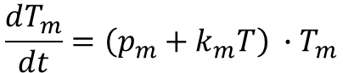
Bifurcation analysis: (How ss changes as parameters change)
I decided to simplify the model for the bifurcation analysis:
$$\frac{dT}{dt}=\left(p−k_{m}T_{m}\right)∙T$$
Cells growth equation
$$\frac{dT_{m}}{dt}=\left(p_{m}+k_{m}T\right) ∙T_{m}$$
Cells infected by mutant Virus
0 $=\left(p−k_{m}T_{m}\right)∙T$
$$0=\left(p_{m}+k_{m}T\right) ∙T_{m}$$
For this kind of growth model, there is going to be a trivial SS
The steady state is going to change as the parameters change in this model

Slide 21
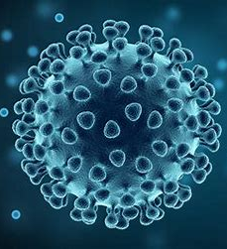
Future Work
In-Depth In Vivo Analysis of HIV-1 Dynamics
Conduct comprehensive studies to explore HIV-1 dynamics in vivo.
Investigating Co-Infection Dynamics and Treatment Impacts:
Explore the dynamics of HIV-1 in the context of co-infections, such as tuberculosis or hepatitis, to understand the interplay between pathogens and their combined effect

Slide 22
Conclusions
Parameter Estimation:
The parameters for the model are very similar to the findings of the paper, but it still requires a way to overcome the dependence of the system on the initial guesses.
Sensitivity Analysis Utility:
For the evaluated model, the sensitivity analysis revealed that the most important parameter affecting all the dynamics of the system was the cell growth rate.
Bifurcation Analysis Insights:
The simplified system presents two steady states, one of which is dependent on the parameters estimation for the model

